Slide 1

GREEN DESTINATION PROJECT REPORT

Slide 2
OBJECTIVE
Green Destinations is a well known travel agency. The HR Director has recently noticed an increase in employees leaving (attrition). She would like to figure out any trends or patterns .She has surveyed the staff of Green Destinations and provided you with the data .
She would like to know what the attrition rate is (% of people who have left).
She would also like to know if factors like age, years at the company and income play a part in determining if people will leave or not.

Slide 3
REPORT DASHBOARD

Slide 4
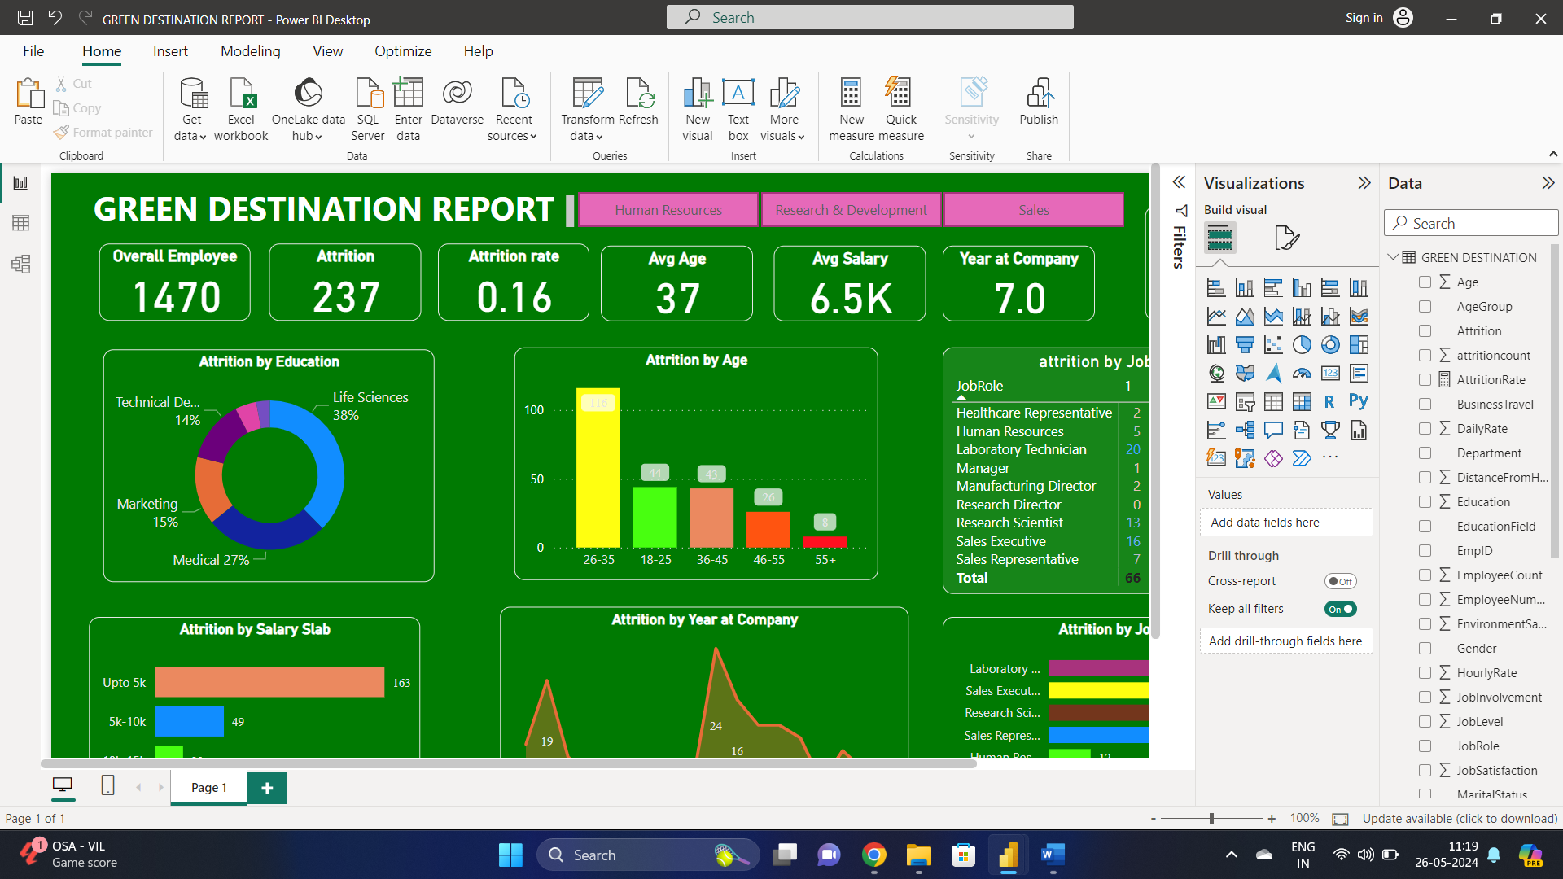

Slide 5
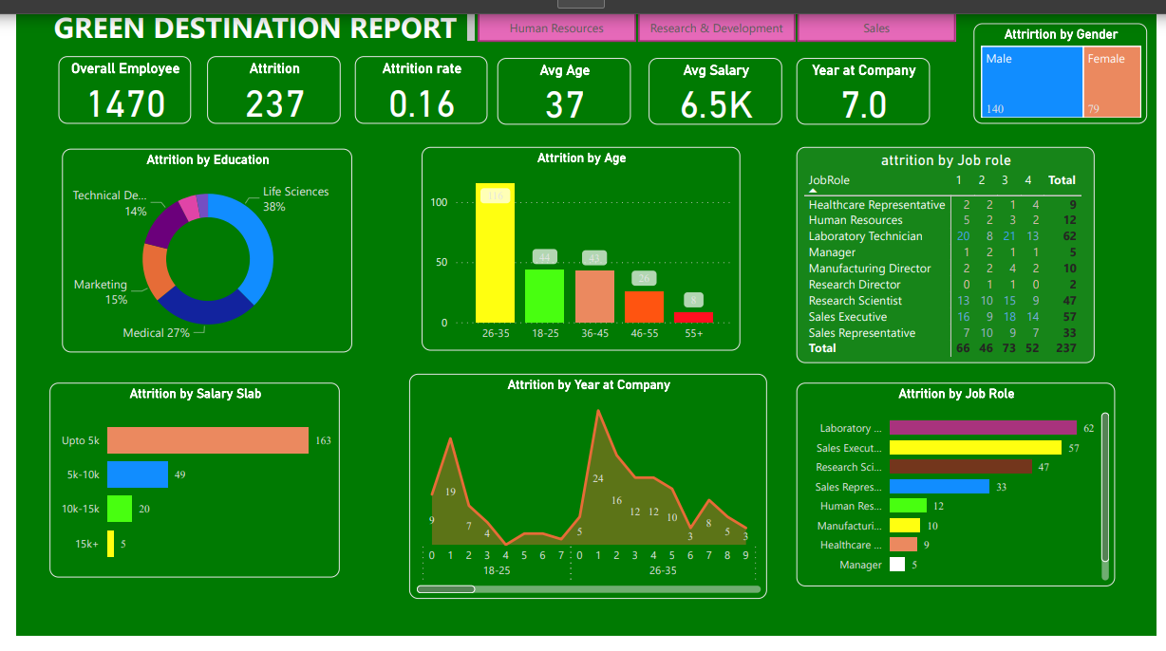

Slide 6
RAW DATA DETAILS

Slide 7
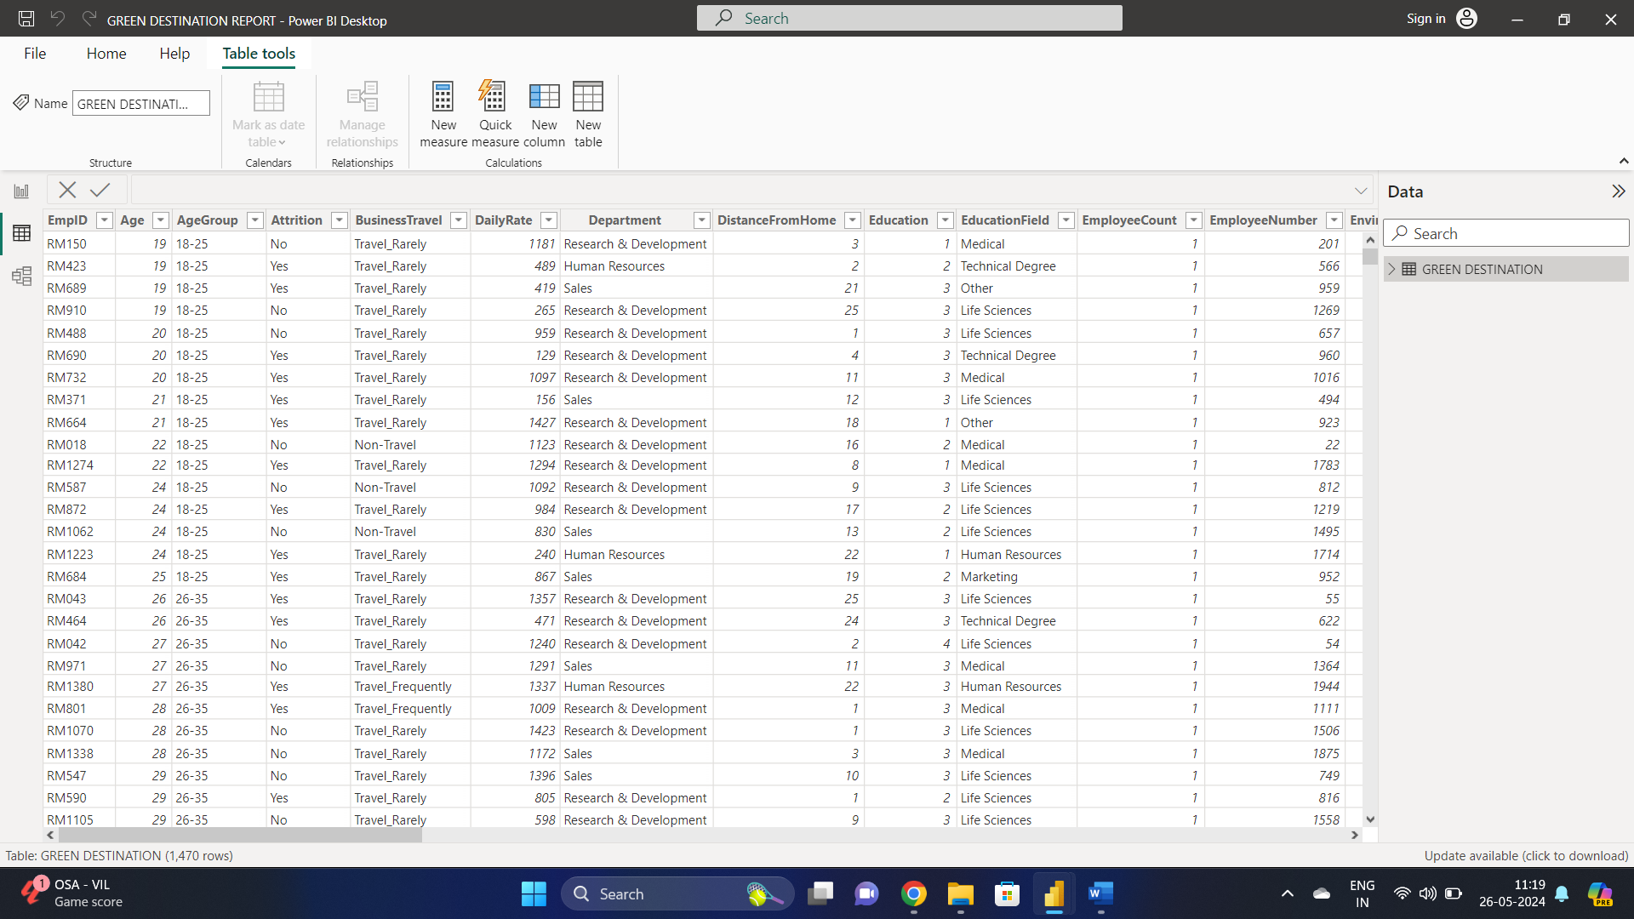

Slide 8
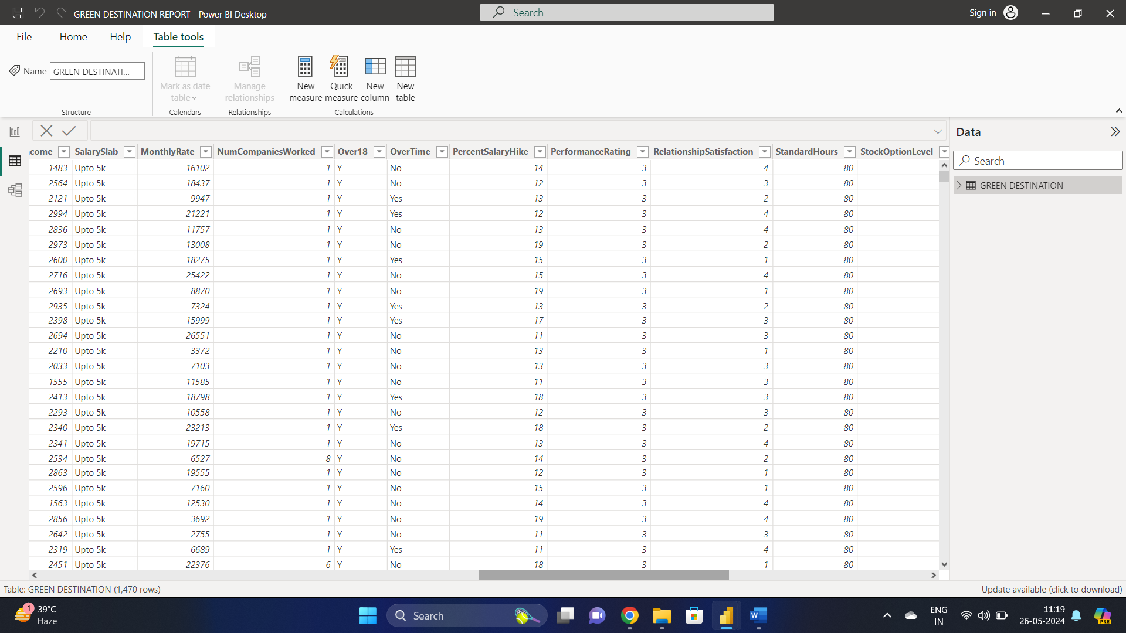

Slide 9
THANK YOU
MADE BY ATUL GARG

